Slide 1
Accident Prevention in Railway

Slide 2
PROTOTYPE DEFINITION
A Project For Avoid Railway Accidents And Provide Safety

Slide 3
PROTOTYPE OVERVIEW
Accident Prevention in Railway :-
was designed, constructed and programmed which may be potentially used for “Avoid Railway Accidents And Provide Safety”.
This project will move platform side wall of railway station for providing safety

Slide 4
PROTOTYPE COMPONENTS COST SPECFICATION
COMPONENTS | COST
Arduino Uno | 400
Ultrasonic Sensor | 100
Servo Motor | 100

Slide 5
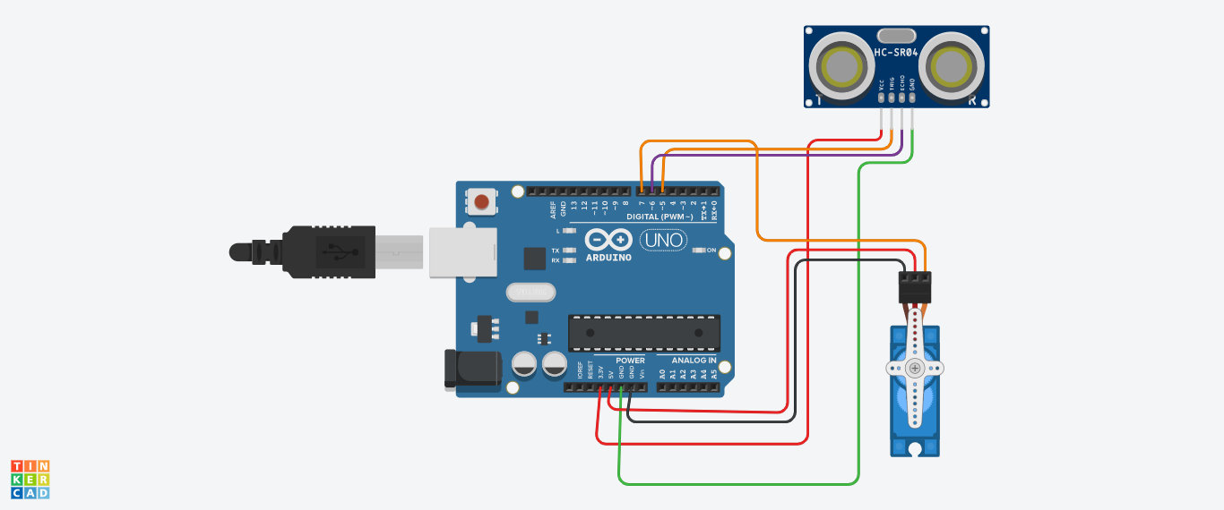
PROTOTYPE BLOCK CIRCUIT DIAGRAM

Slide 6
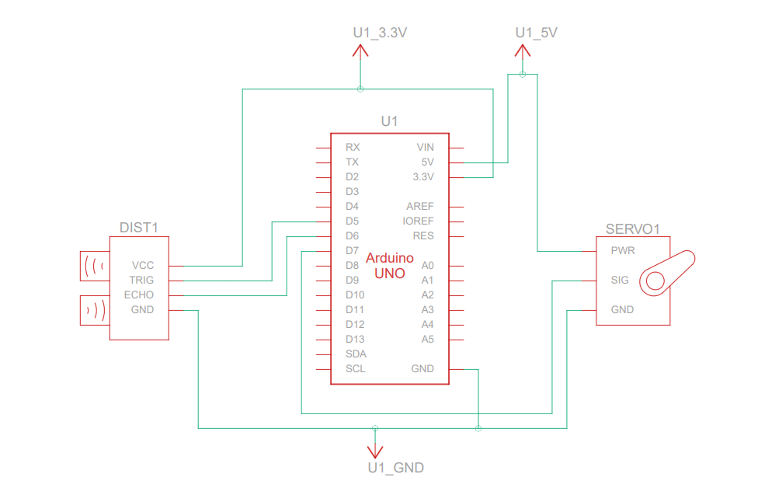
PROTOTYPE SCHEMATIC CIRCUIT DIAGRAM

Slide 7
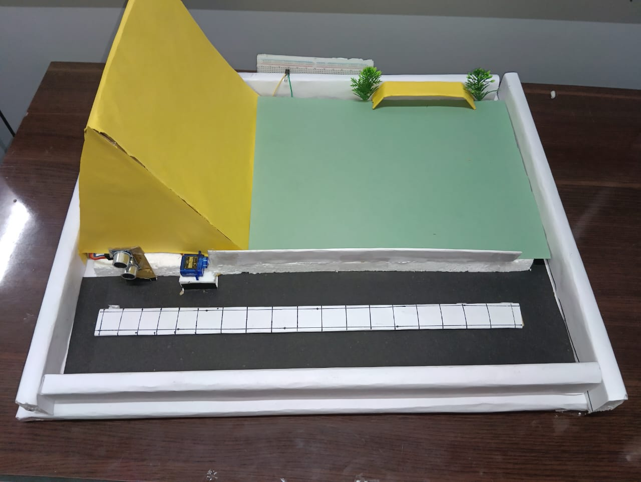
PROTOTYPE HARDWARE COMPONENT ASSEMBLED LABELLED DISPLAY
LED light
ultrasonic sensor
servo motor

Slide 8
PROTOTYPE CODE
##include <Servo.h>
const int trigPin = 5; // Trigger pin of the ultrasonic sensor
const int echoPin = 6; // Echo pin of the ultrasonic sensor
const int servoPin = 7; // Servo control pin
int ledPin = 8; // You can choose any digital pin
Servo myservo; // Create a servo object
void setup() {
pinMode(trigPin, OUTPUT);
pinMode(echoPin, INPUT);
myservo.attach(servoPin); // Attaches the servo to the servoPin
Serial.begin(9600);
pinMode(ledPin, OUTPUT); // Set LED pin as output
}
void loop() {
long duration, distance;
}

Slide 9
// Send a pulse to the ultrasonic sensor to trigger a measurement
digitalWrite(trigPin, HIGH);
delayMicroseconds(10);
digitalWrite(trigPin, LOW);
delayMicroseconds(2);
digitalWrite(trigPin, HIGH);
// Measure the time it takes for the echo to return
duration = pulseIn(echoPin, HIGH);
// Calculate the distance in centimeters
distance = (duration / 2) / 29.1;
// Print the distance to the Serial Monitor
Serial.print("Distance: ");
Serial.print(distance);
Serial.println(" cm");
// If an object is detected within a certain range, move the servo 90 degrees
if (distance <= 7) { // You can adjust the distance threshold as needed00
myservo.write(90); // Rotate the servo to 90 degrees
delay(200); // Wait for the servo to reach the desired position
// Object detected, blink the LED
digitalWrite(ledPin, HIGH);
delay(200); // Adjust delay for desired blink rate
} else {
myservo.write(0); // Rotate the servo back to 0 degrees
delay(200); // Wait for the servo to reach the desired position
digitalWrite(ledPin, LOW);
}

Slide 10
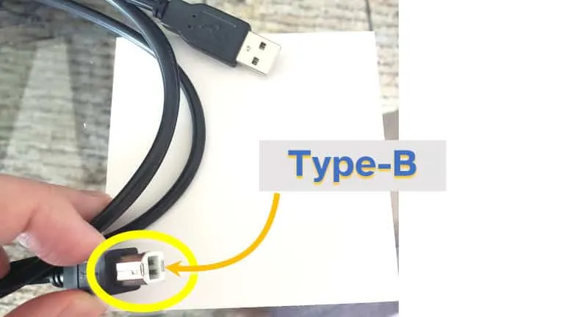
PROTOTYPE CODE UPLOADING STEPS
Step 1: Connect Arduino using a USB Cable

Slide 11
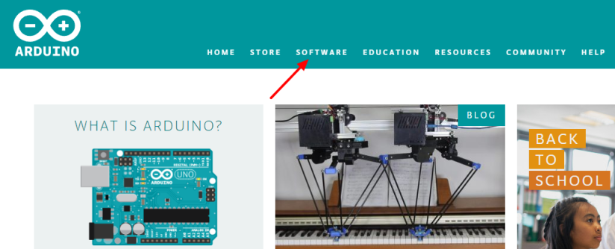
First up all, open the browser and search Arduino software on the Google search engine. You will find the official software link to download
Download IDE

Slide 12
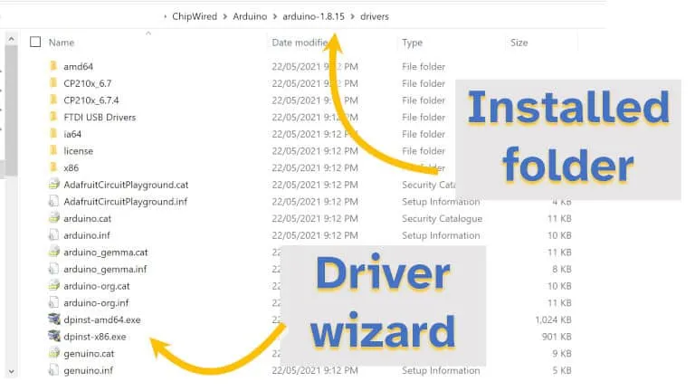
Step 2: Open the Arduino IDE

Slide 13
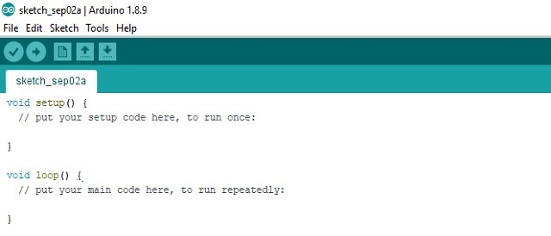
After the successful software installation, open the installed Arduino software. This will look like as below picture where you can edit code.
Write a code

Slide 14
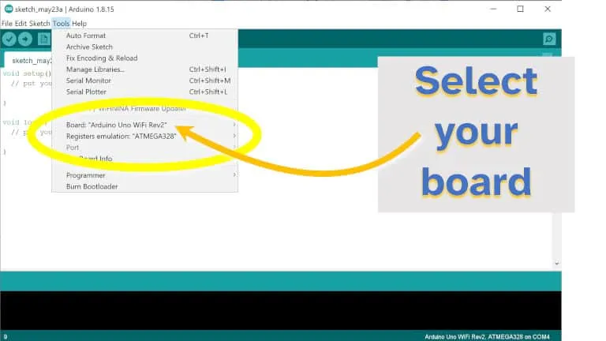
Step 3: Select the Arduino Board and Port

Slide 15
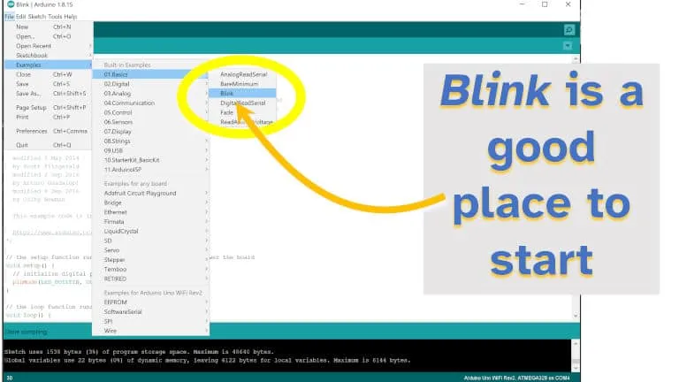
Step 4: Prepare a Sketch (or write some code)

Slide 16
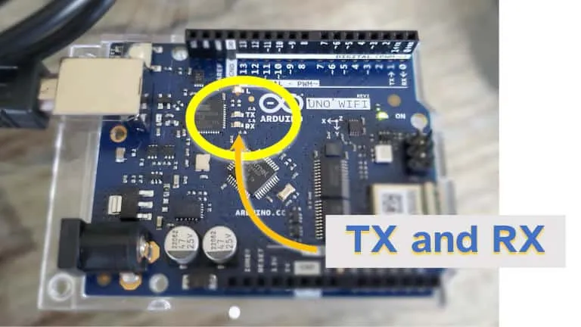
Step 5: Upload Sketch (look for the Tx and Rx LEDs flashing)

Slide 17

Finishing Up
After following these steps, you should now have:
An Arduino connected to your computer
An IDE that uploads code/sketches from your computer to your Arduino
An Arduino that executes the code that was uploaded to it

Slide 18
PROTOTYPE GHANTT CHART

Slide 19
ADVANTAGES
Acts automatically to prevent collisions.
Economical and cost effective.
Elimination of human error as no inputs are to be fed by the crew.

Slide 20
DISADVANTAGES
A disadvantage with “Accident Prevention in Railway”
➢ System cannot work efficiently in rough environments.

Slide 21
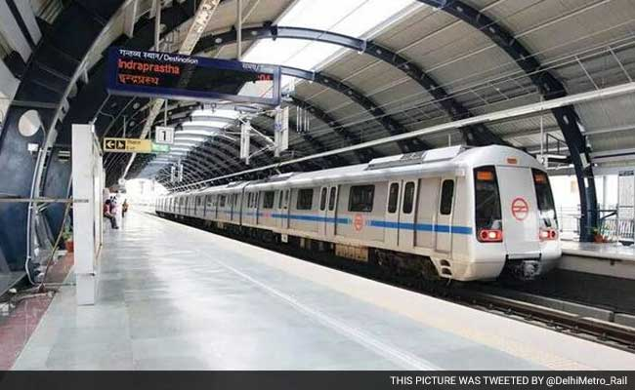
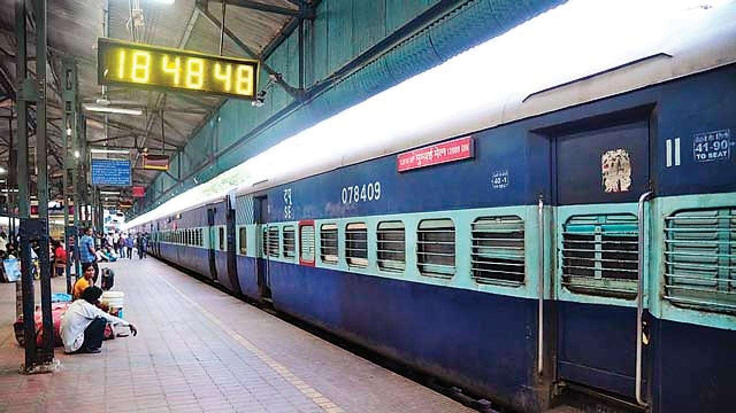
PROTOTYPE REAL LIFE APPLICATIONS
Metro Station
Railway Station

Slide 22
CONCLUSION (PROTOTYPE WORK LEARNING)
This project provides an module that detects obstacles coming in its path.
For object detection, ultrasonic sensors have been used that provides a wider field of view.
Servo motor has been used for rotating the sensor.

Slide 23
PROTOTYPE FUTURE ENHANCEMENT
Add more “Sensor” for Efficiency.

Slide 24
REFERENCES
https://harishprojectss.blogspot.com/2020/12/smart-railway-station-accident.html
https://www.tinkercad.com/things/djyYePezDKf-glorious-esboo-jaiks/editel

